Slide 1
SCILAB LECTURE DISCETE TIME SIGNALS
Ashok Ranade

Slide 2
Time domain description
x(t) denotes a signal
x denotes the amplitude- dependent variable
t denotes time – independent variable
Nature of variables
Continuous
Discrete

Slide 3
Analog signal
Both x and t continuous variables (Continuous Amplitude, Continuous time CA/CT) : Analog signal
CA/CT Signal
x
t

Slide 4
Digital signal
DA/DT
Most transducers give analog signal
Microphone output
Thermocouple
Analog to Digital converters
Convert analog signal into a digital signal

Slide 5
ADC operations
Sampling
This converts CA/CT signal into CA/DT signals
CA/DT Signal
x
0
ts
2ts
t
Sampling frequency(fs)
>= 2 fmax (Nyquist rate)

Slide 6
Examples
Speech signal
fmax = 3.5 KHz
Sampling frequency = 8 Ksamples/s
Sound signal
fmax = 20 KHz
Sampling frequency fs = 48 Ksamples/s

Slide 7
How sampling can be achieved
A multiplier
One input is the analog signal
The other input is a periodic train of narrow pulses
vi
vo
vi
Multiplier
1
p(t)
p(t)
vo

Slide 8
Quantization
4
111
3.5
110
q= 1
2.5
101
1.5
100
.5
x(t)
0
t
011
- .5
010
-1.5
001
-2.5
000
-3.5
-4

Slide 9
Quantization
This converts continuous amplitude to discrete amplitude
DA/DT Signal
x
t

Slide 10
Encoding
Encoder converts quantized amplitudes to binary values
Analog Signal
Analog to
Digital
Converter
Binary Signal

Slide 11
Summary of Analog to Digital Conversion
Sampling
Converts CA/CT signal to CA/DT signal
Quantization
Converts CA/DT signal to DA/DT signal
Encoding
Gives binary output

Slide 12
Serial transmission
Each bit is read one at a time
Binary Signal
Analog Signal
Serial output
Analog to
Digital
Converter
Parallel to serial converter

Slide 13
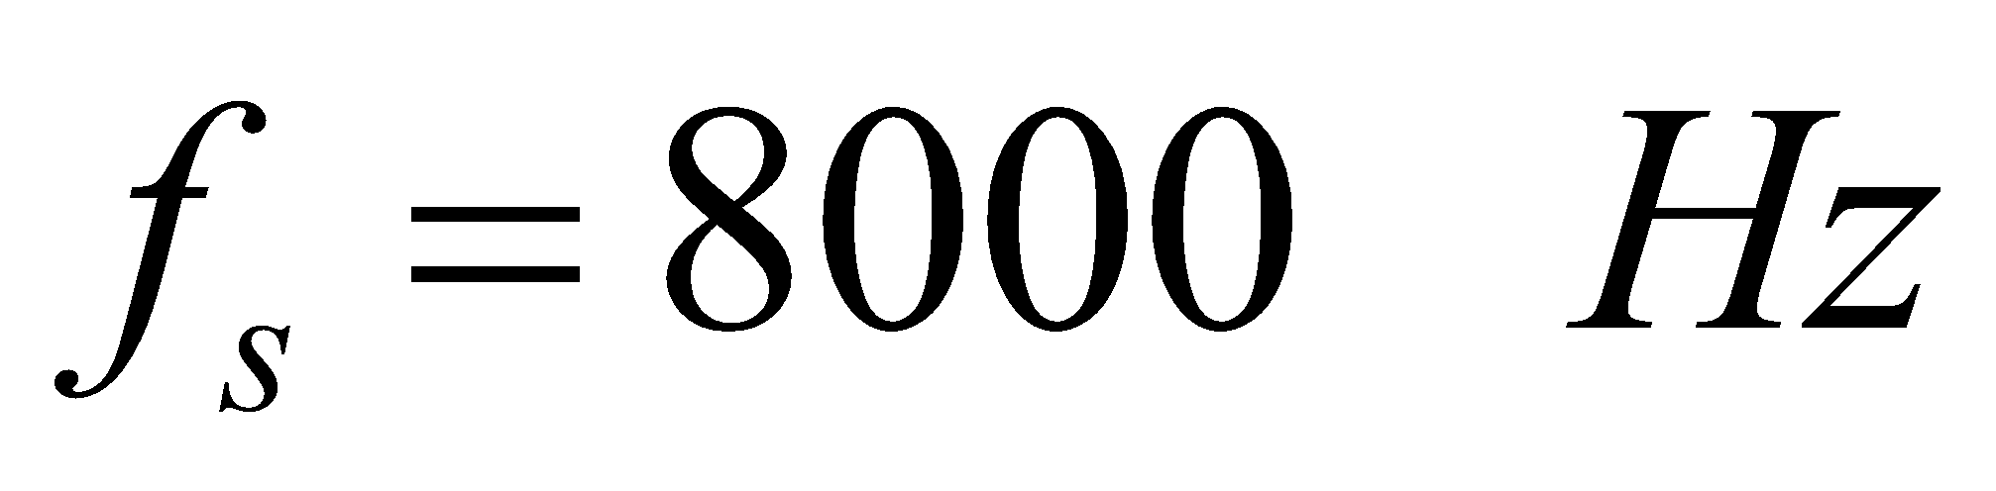
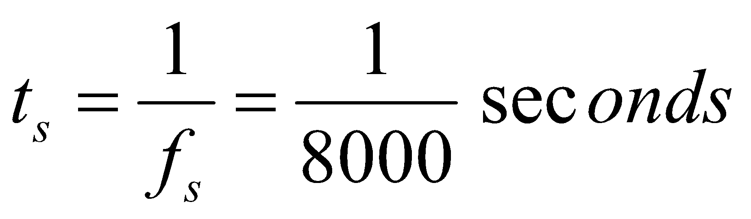
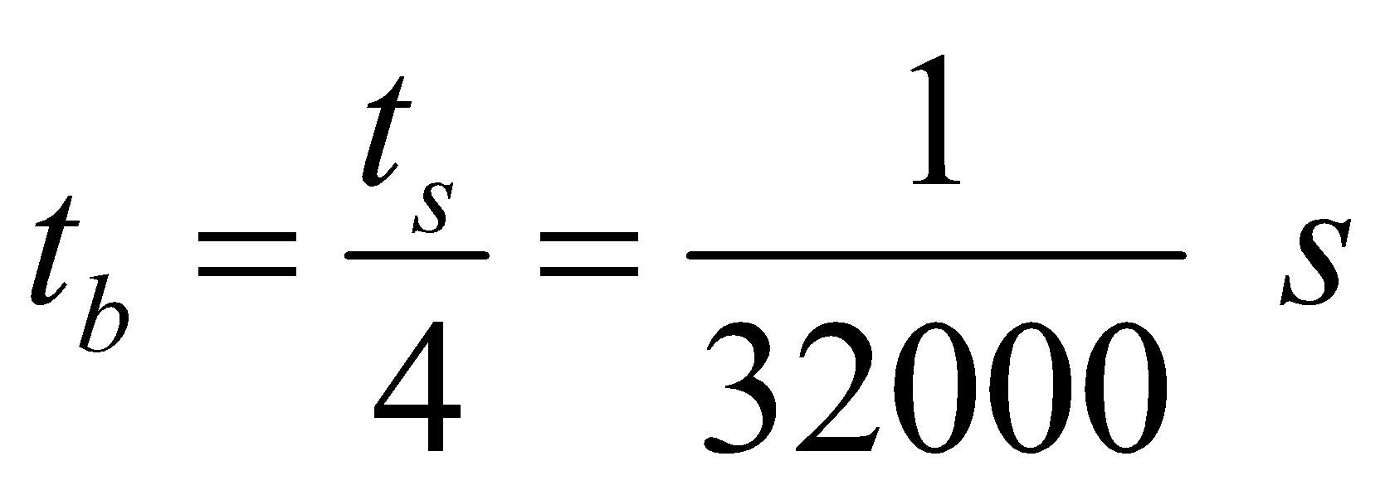
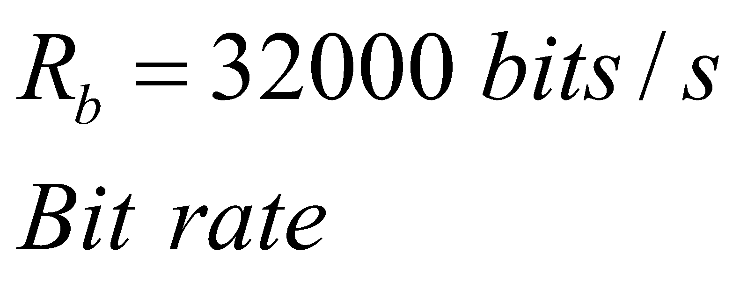
An example
Speech signal
Sampling frequency 8000 samples/s
4 bits per sample
t_{s}
2t_{s}
0
tb

Slide 14
Discrete amplitude and Continuous time (DA/CT)
x
t
DA/CT Signal
Digital input
Digital to
Analog converter
Analog Filter
Analog Output
CA/CT

Slide 15
Basic Elements of a DSP System
Digital signal processor
ADC
DAC+Filter
Analog Output
Analog input
EOC
Start conversion

Slide 16
Comparison of DSP and ASP
Feature | ASP | DSP
Speed | Fast | Moderate
Cost | Low to moderate | Moderate
Flexibility | Low | High
Performance | Moderate | High
Self calibrating | No | Yes
Data logging capability | Limited | High
Adaptive capability | Limited | High

Slide 17
Discrete Time signal

Slide 18
Digital signal
Discrete time
Discrete amplitude
Digital signal
x(nTs)
-Ts 0 Ts 2Ts 3Ts 4Ts 5Ts
t= nTs

Slide 19
Simplified notation
x(n)
-1 0 1 2 3 4 5
n

Slide 20
Normalized variable n
The discrete time variable is nTs, where n is an integer.
Usually only n is used
Because processing algorithms do not need Ts.
For example consider the calculation of running average
For implementation it is important to know Ts since the processing required for current sample must be finished before the next sample comes in. So the processor must have required speed.

Slide 21
A ramp signal
// A discrete ramp signal ;
clear; clf; clc;
n = 0: 10;
x = n;
subplot(211);
plot2d3(n,x);
subplot(212);
bar(n,x,0.08,'red');

Slide 22
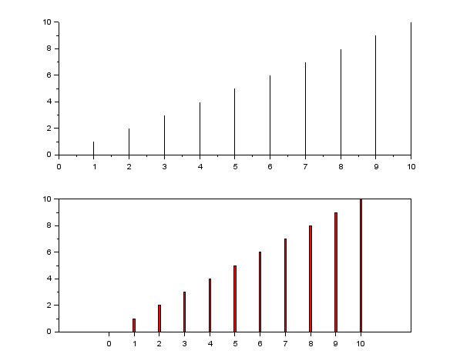
Output

Slide 23
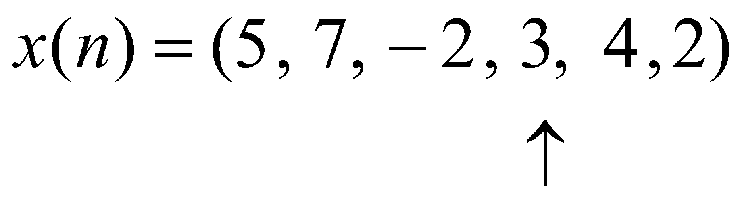
Discrete signal as a sequence
n | -3 | -2 | -1 | 0 | 1 | 2
x(n) | 5 | 7 | -2 | 3 | 4 | 2
Scilab Representation
n = -3:2;
x = [5 , 7, -2, 3, 4, 2];
Shorthand notation

Slide 24
Plotting a discrete signal
clear;
clf;
n = -3:4;
x = [0 1 2 4 3 5 6 4 ];
plot2d3(n,x);
xlabel("n","fontsize",4);
ylabel("x","fontsize",4);
title("Plot of a discrete signal","fontsize",4); xgrid(4);

Slide 25
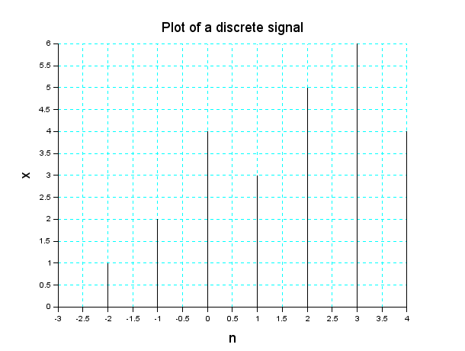
Program output

Slide 26
Exercise
Generate and plot two discrete signals x(n1) and y(n2)
Range of n1 could be different than that of n2.
Explore the bar option instead of plot2d3
bar(n,x,0.05,'yellow');
Line width (0 to 1)

Slide 27
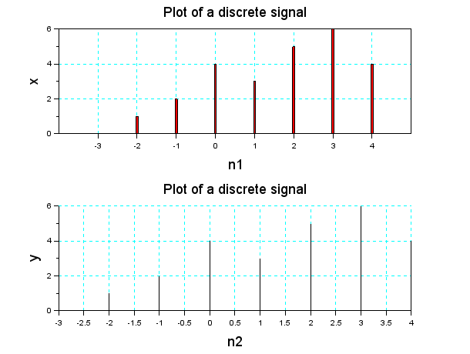
Output

Slide 28
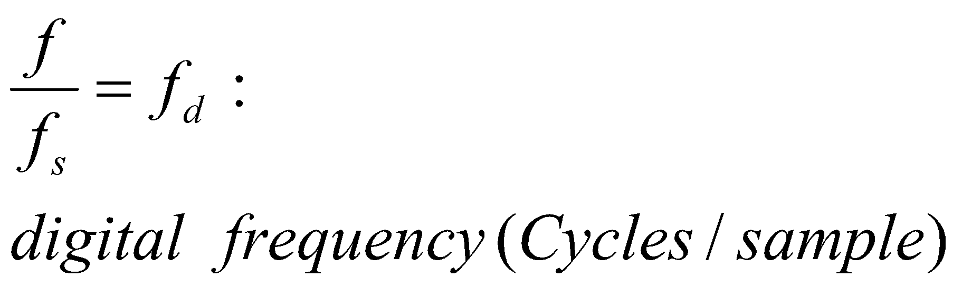
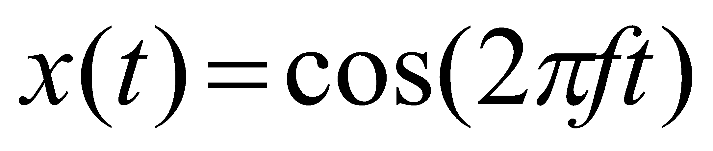
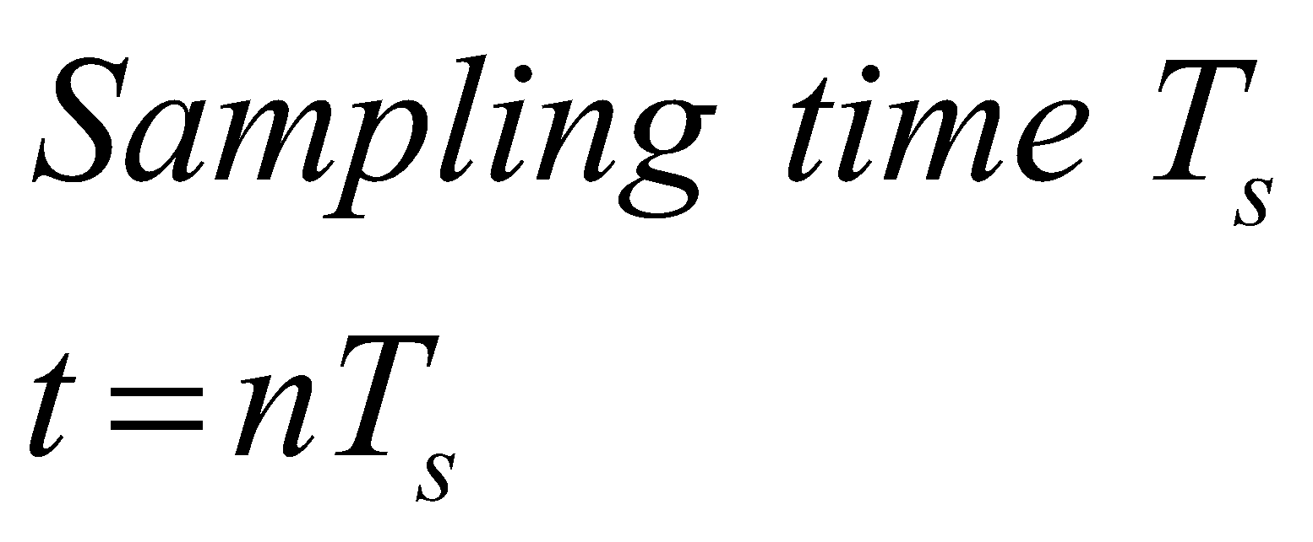
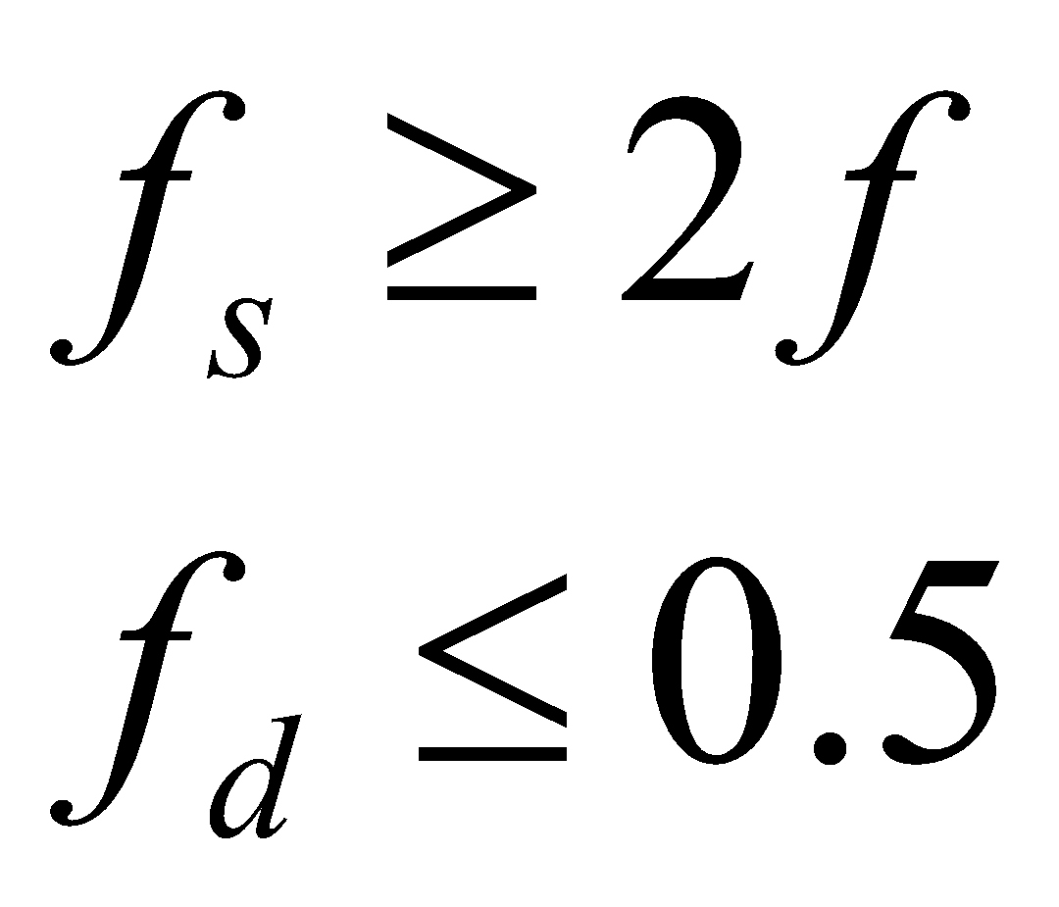
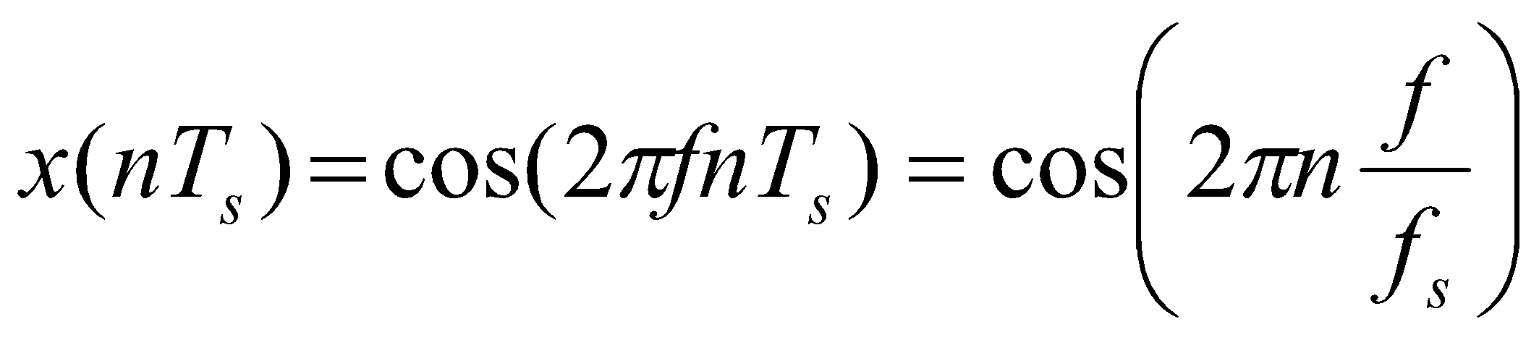
Relation between analog cosine and digital cosine wave
Analog signal

Slide 29
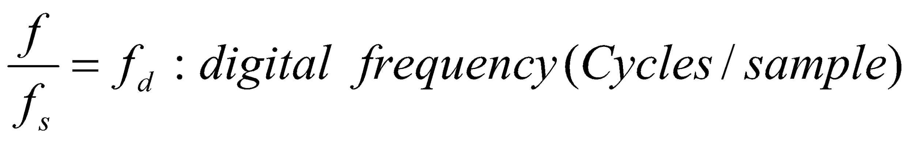
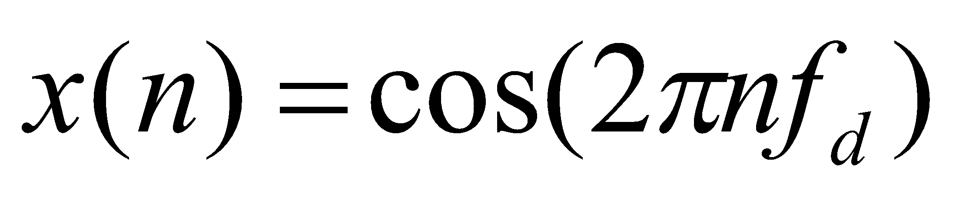
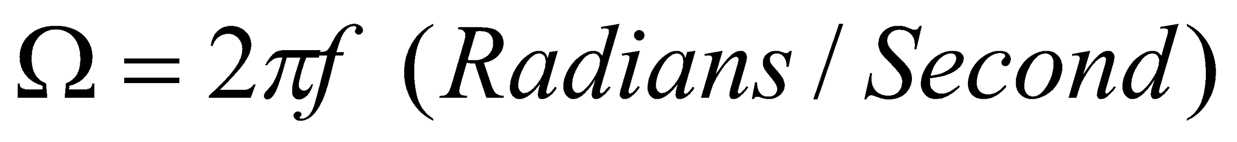
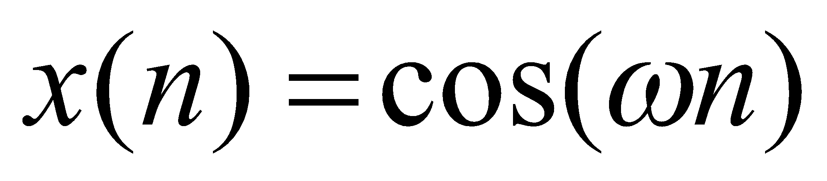
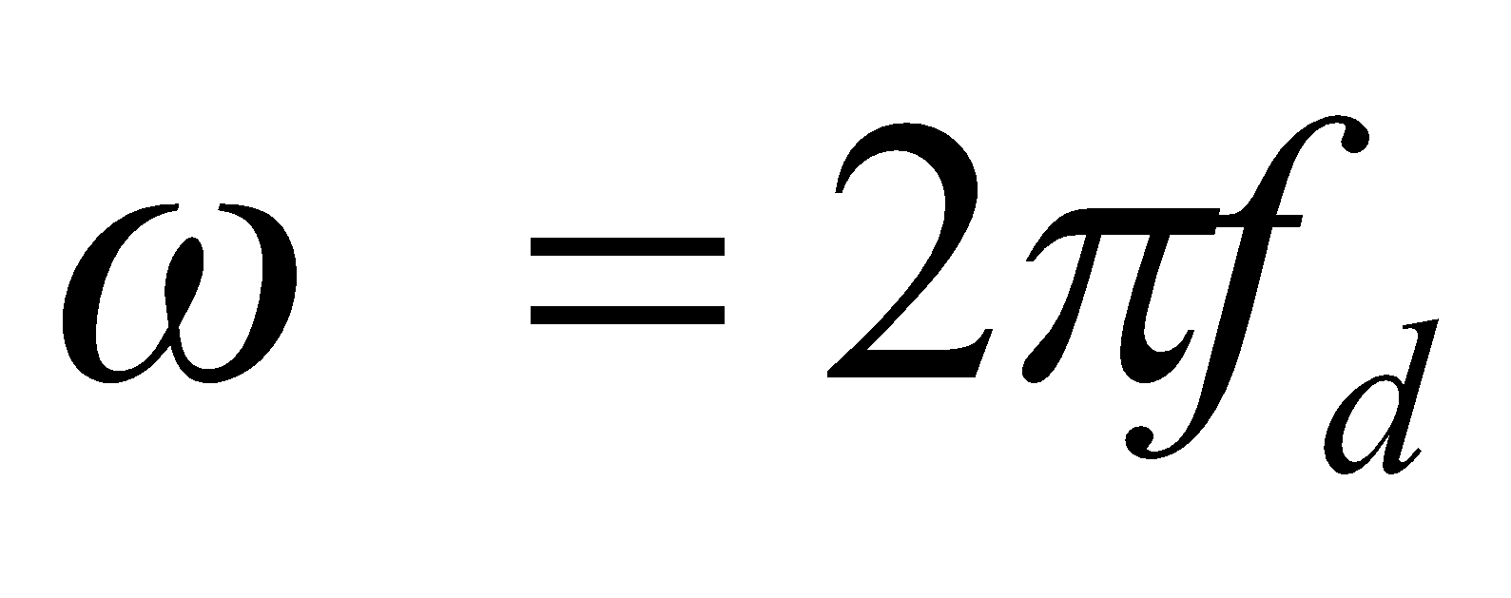
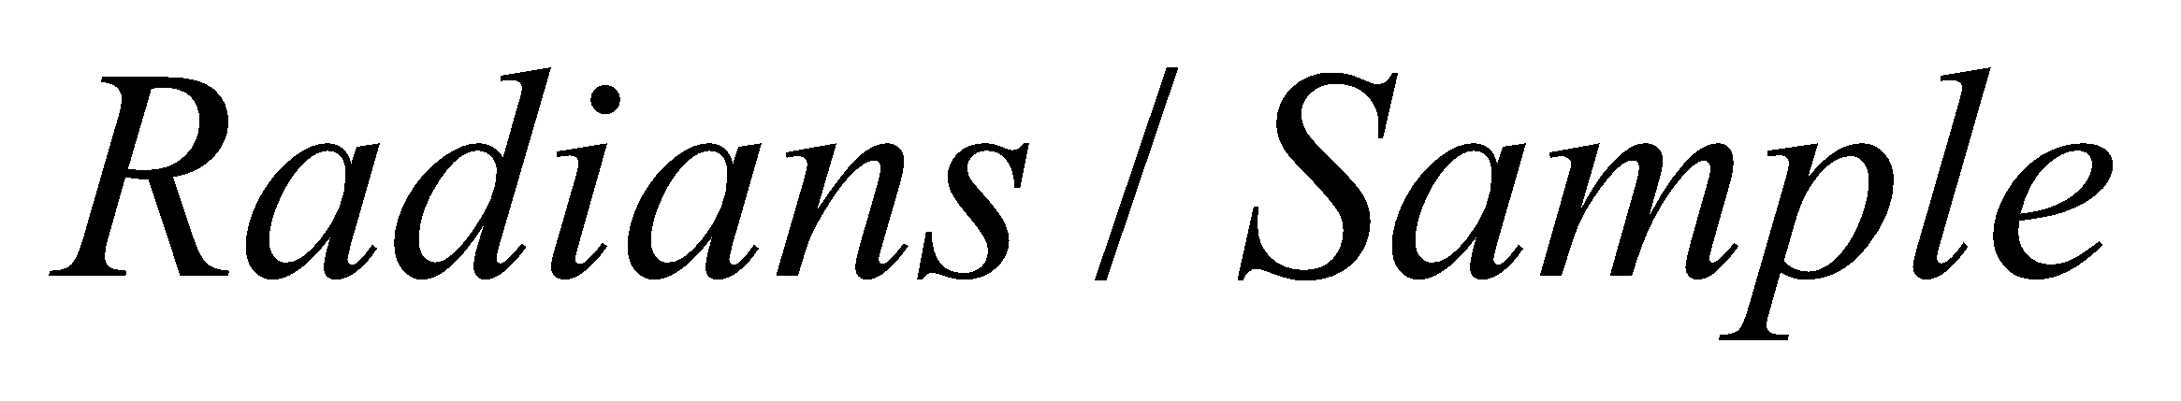
Discrete Time cosine wave

Slide 30
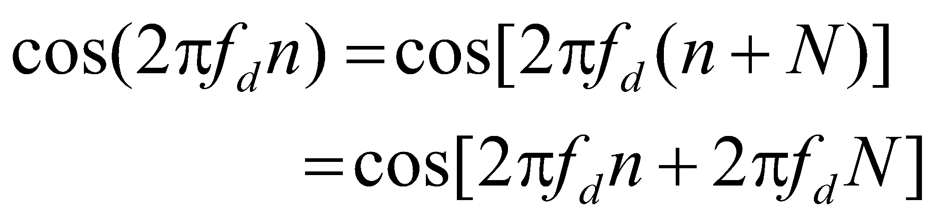
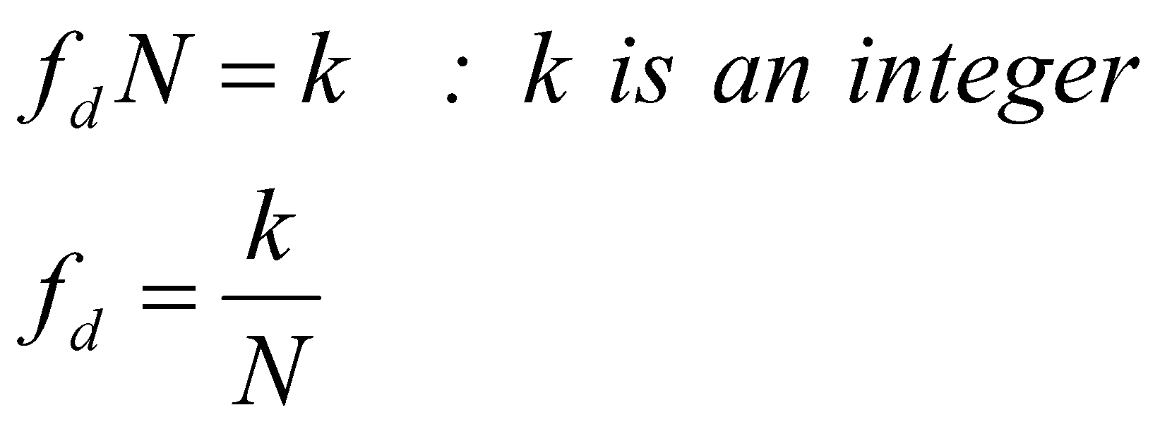
Periodicity of discrete cosine wave
N is the number of samples after which the wave repeats

Slide 31
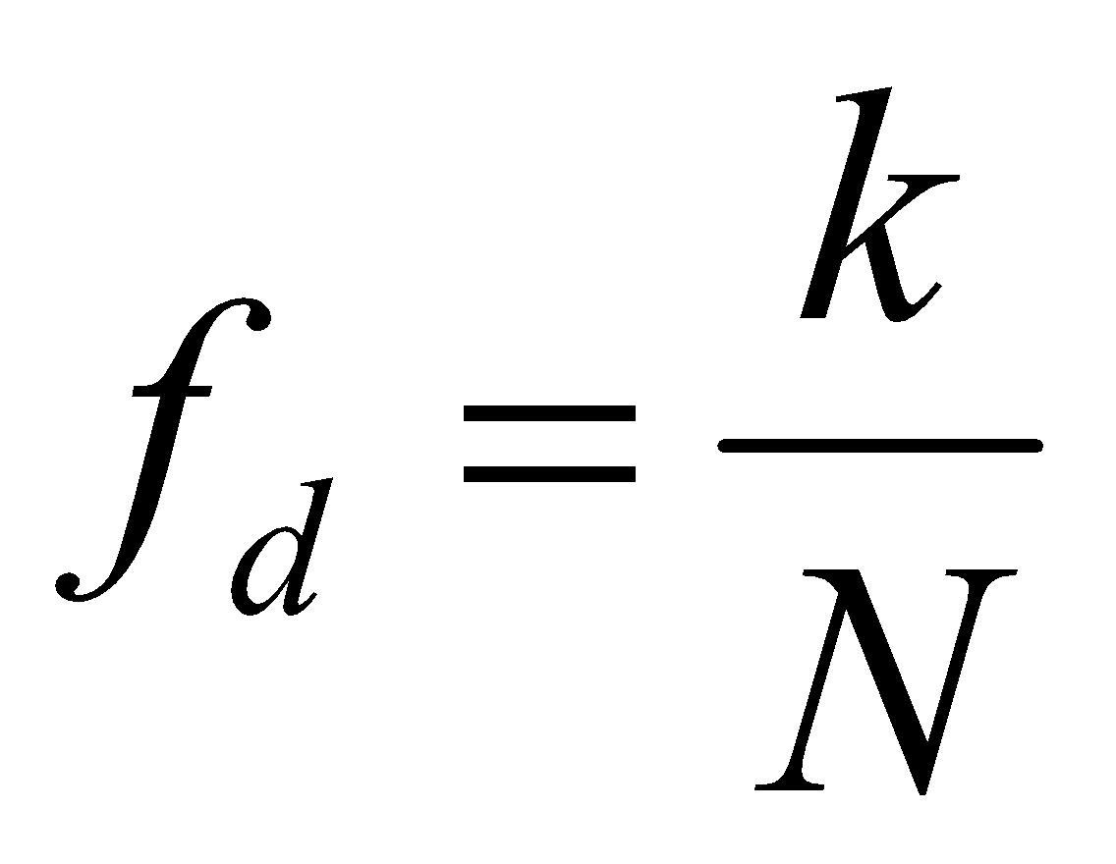
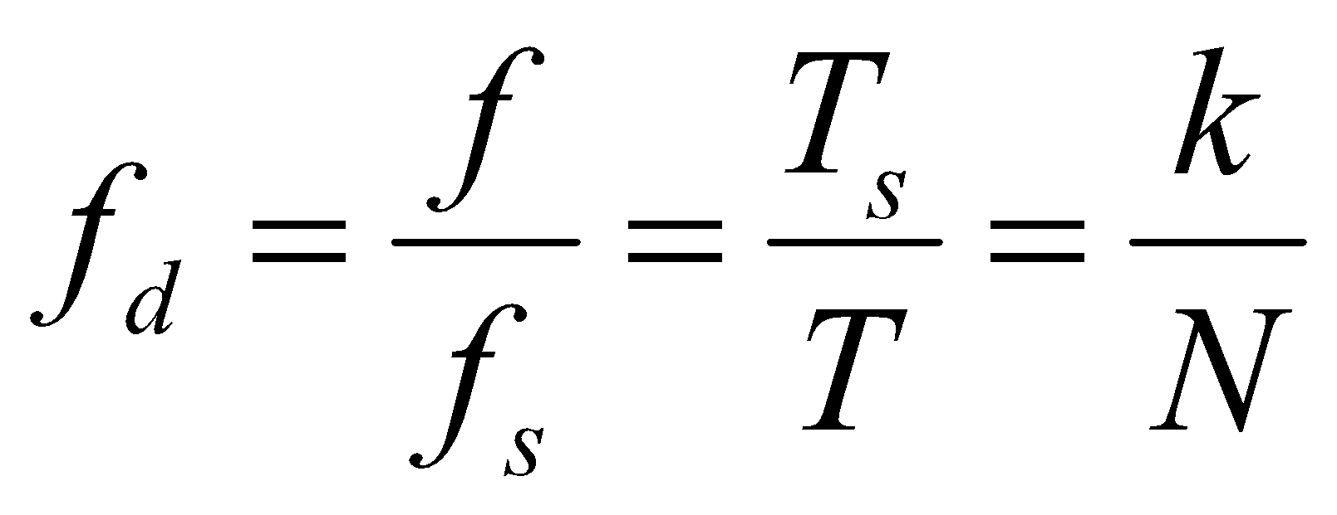
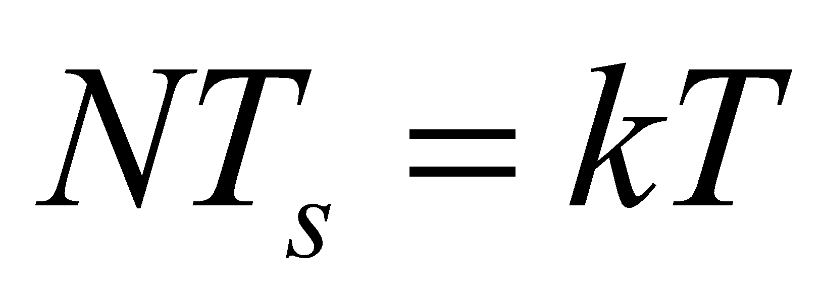
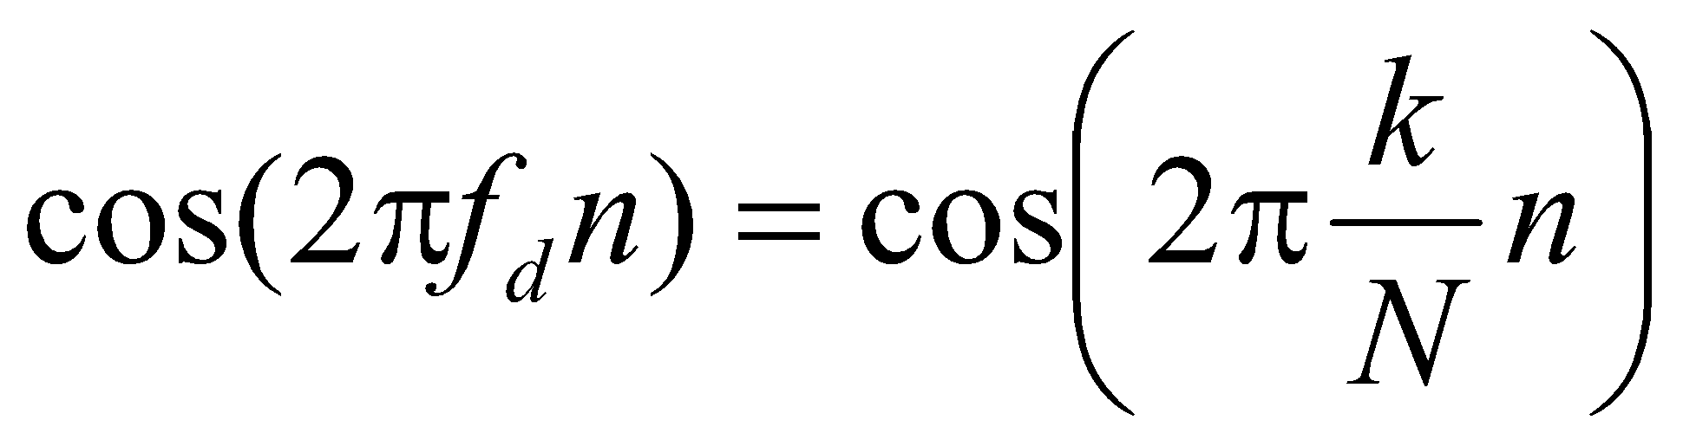
Relation between analog period and digital period
Time of N samples(One cycle of discrete sine wave) corresponds to k cycles of the analog sine wave.

Slide 32
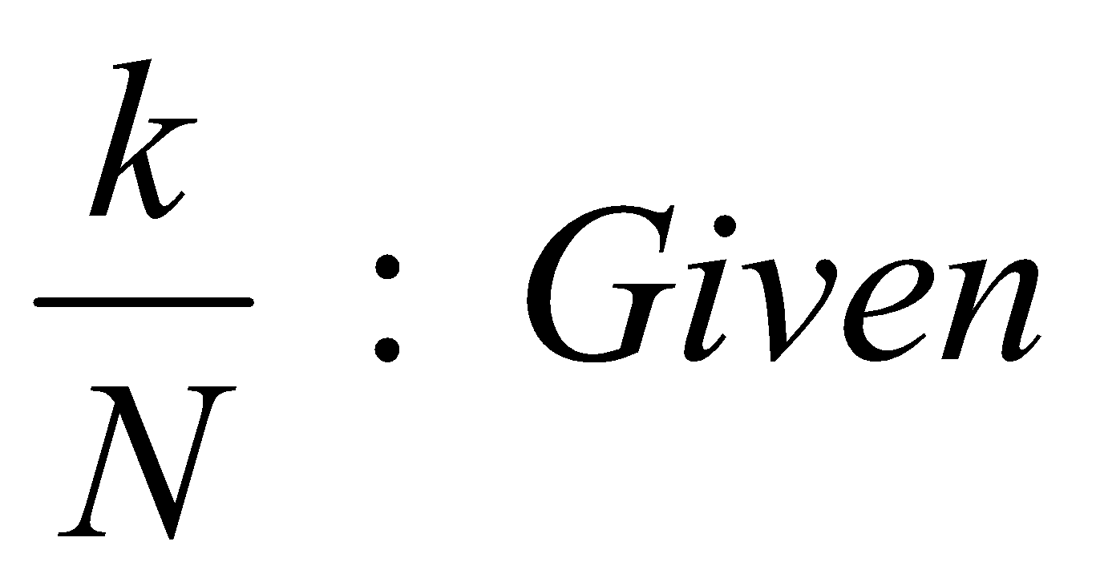
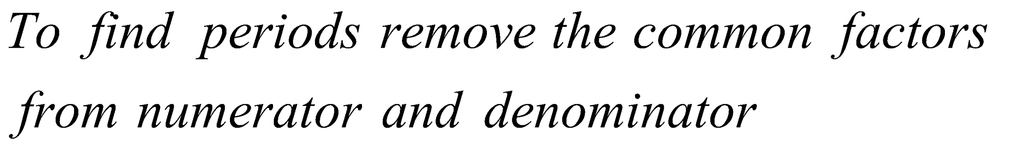
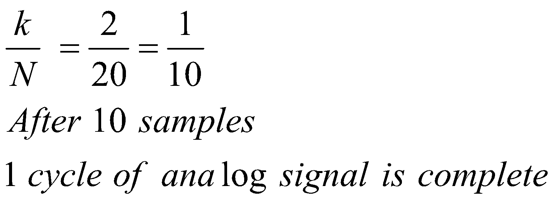
Finding the time period

Slide 33
Examples
k/N = 3/20
Discrete time signal repeats after 20 samples
During this time analog signal completes 3 cycles
k/N = 30/60
Remove common factors so k/N = ½. Wave repeats
after 2 samples and completes one cycle of sine
wave.
k/N = 31/60. Now the wave repeats after 60 samples and completes 31 cycles of analog sine signal

Slide 34
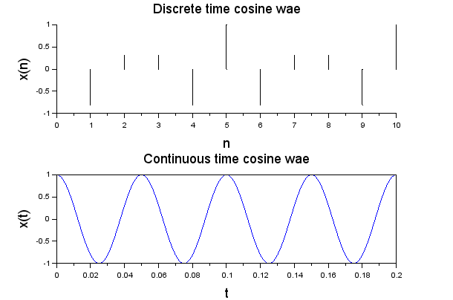
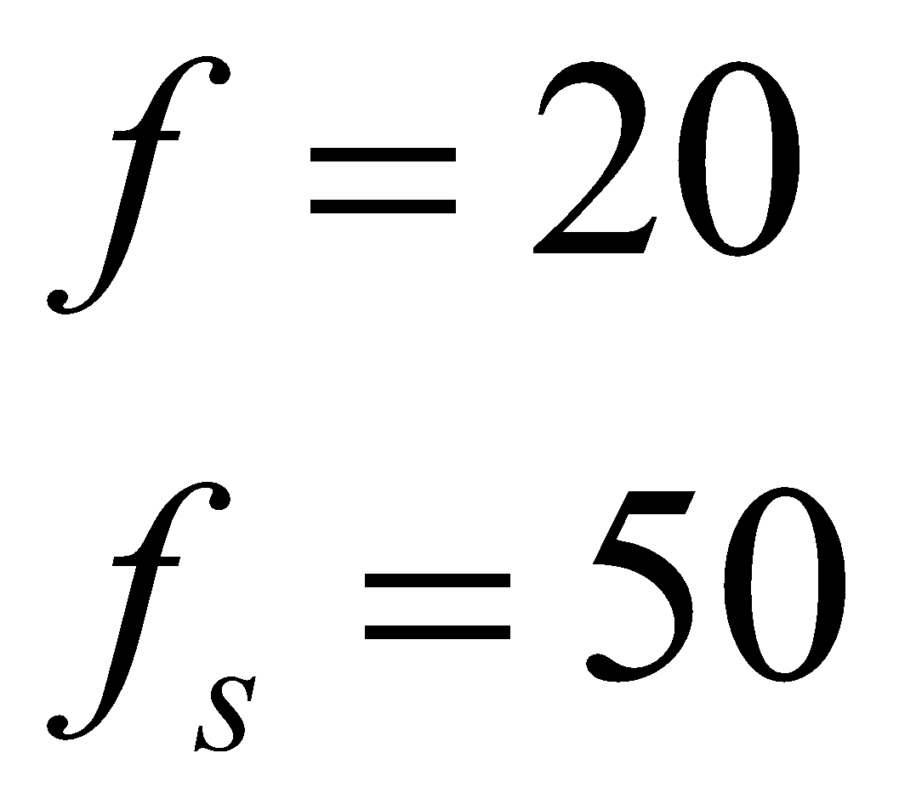
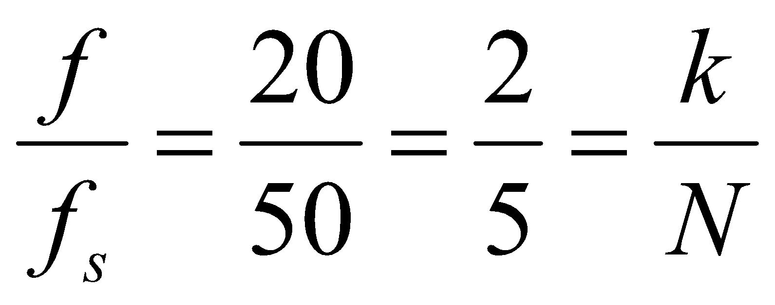
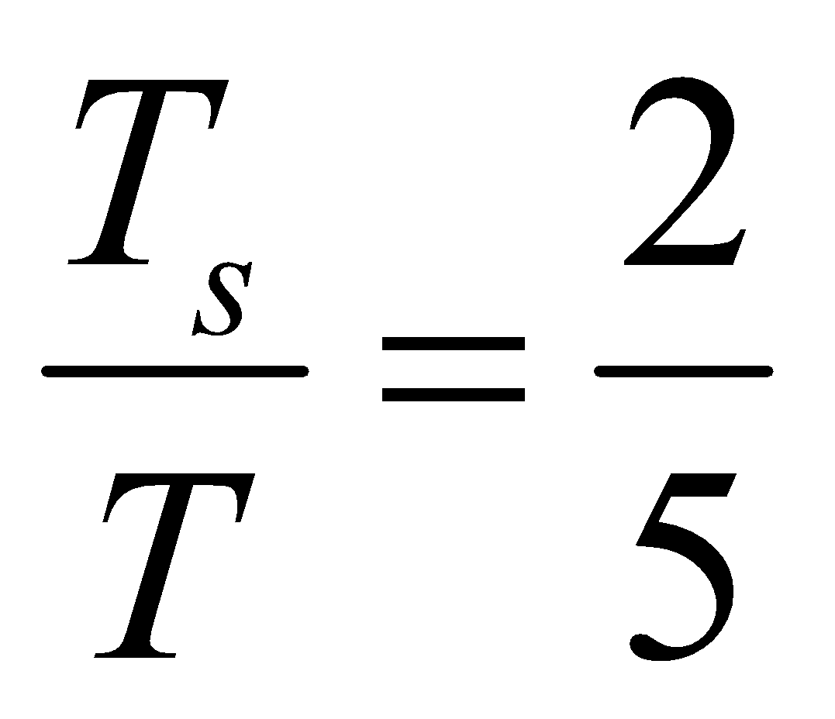
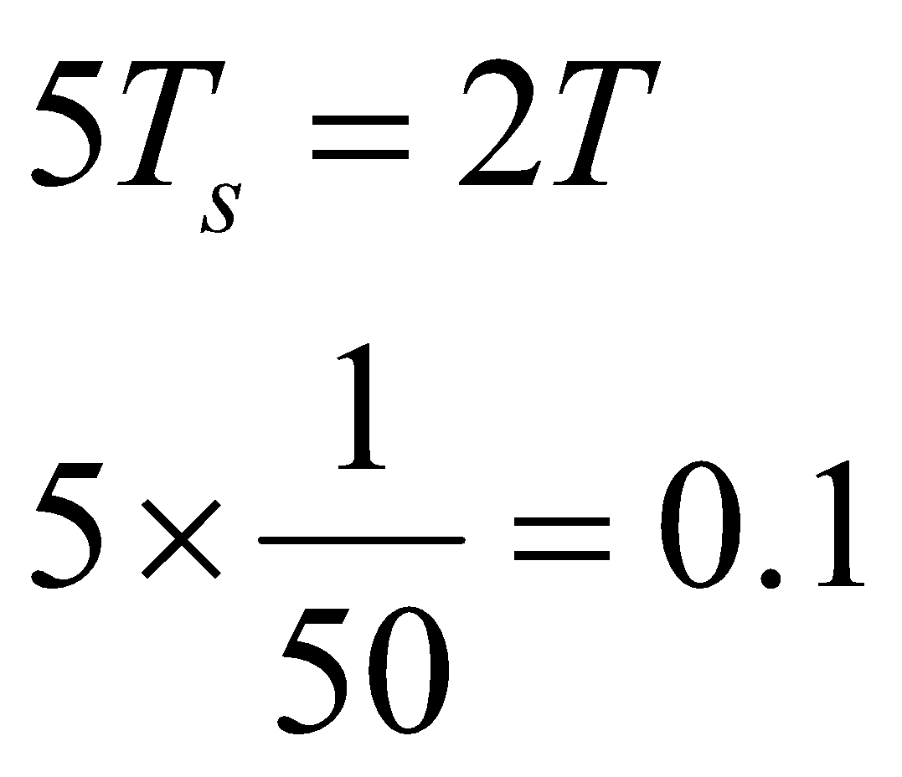
Example

Slide 35
Scilab Program
clear; clf;
k = 1; N = 20;
n = 0 : 40;
A = 1;
x = A*cos(2*%pi*n*k/N);
plot2d3(n,x );
xgrid(2);
xlabel("n", "fontsize",4); ylabel("x(n)", "fontsize",4); title("Discrete time cosine wave", "fontsize",4);

Slide 36
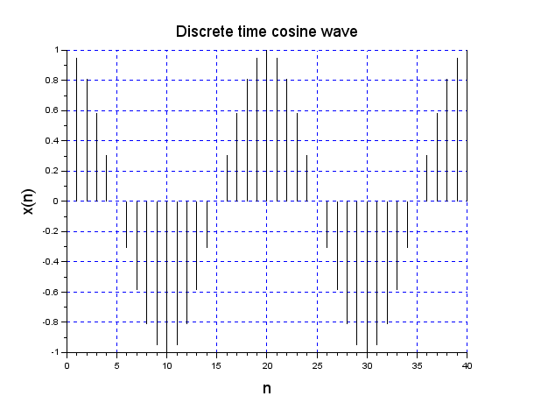
Program Output

Slide 37
Assignment
Modify the program to plot two line plots . One for k =1 and one for k =2. Vary n from 0 to 20. Place the plots one below the other
Explore the bar option instead of plot2d3
bar(n,x,0.05,'yellow');
Line width (0 to 1)

Slide 38
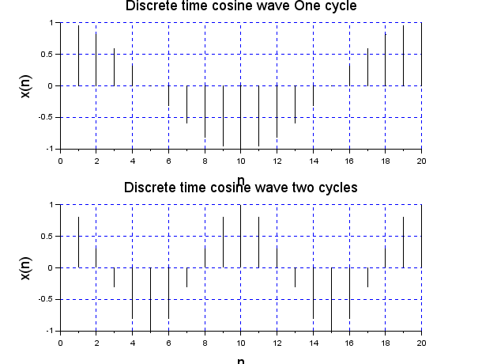
Result

Slide 39
Zero Padding
Signal length can be increased by adding zero valued samples outside the range
x(n) = { 3, -2, 1, 0, 2, -3, -1, 0, 2, 1 }
The length is 10. This can be increased
x(n) = { 0,0,3, -2, 1, 0, 2, -3, -1, 0, 2, 1,0,0 }
Now N = 14

Slide 40
Zeros and length function
zeros(n,m)
Generates a matrix of zeros of the dimension nxm
We often use zeros(1:m)
length(x)
returns the number of elements in matrix x
Program for adding two vectors
First make the two vectors of same length
Append trailing zeros to vector of smaller length
Assume that both start at n(1) = 0

Slide 41
Basic operations
Addition
z(n) = x(n) + y(n)
Subtraction
z(n) = x(n) - y(n)
Multiplication
z(n) = x(n) . Y(n)
Division
z(n) = x(n)/y(n)

Slide 42
Scilab Example
Assume two signals of same length
Assume common n vector
n = [-2 -1 0 1];
x = [1 , 2 , 3 , 4]
y = [5, 6, 7, 8]
z= x +y
z = [6 ,8, 10, 12]
Write a Scilab program to define n,x,y. And calculate z. Display all i.e. n,x,y,z

Slide 43
Modification of program
Modify the program to obtain z = x*y
Use point wise multiplication
z = x.*y
Note that x*y will be a matrix multiplication in scilab

Slide 44
Program
// Discrete signal addition
clear; clc;
n = -2:4 ;
x = [1 4 2 6 4 7 3];
y = [2 -3 5 -1 8 9 3]; z = x+y;
disp("n",n);
disp("x",a);
disp("y",y);
disp("z",z);

Slide 45
Operation on signals of different lengths
n1 | -3 | -2 | -1 | 0 | 1
x1 | 3 | 2 | 6 | 2 | 1
n2 |  | -2 | -1 | 0 | 1 | 2 | 3
x2 |  | 3 | 4 | -1 | 3 | 6 | 2
n | -3 | -2 | -1 | 0 | 1 | 2 | 3
x1 | 3 | 2 | 6 | 2 | 1 | 0 | 0
x2 | 0 | 3 | 4 | -1 | 3 | 6 | 2
x1+x2 | 3 | 5 | 10 | 1 | 4 | 6 | 2

Slide 46
Assignment
Inputs to the program
n1 and x1 arrays
n2 and x2 arrays
Output should be
n
x1 with prefix and suffix zeros
x2 with prefix and suffix zeros
Now any operation can be done x1+x2 : x1*x2 etc

Slide 47
Example vectors
x = ( 1 5 3)
y = ( 2 4 5 6 7 8)
Append three zeros to x and then add
Method in Scilab
x = [x zeros(1,3)]
Study absolute function : abs(M);
Use of If then else
Also study disp() function

Slide 48
Scilab program
clear; clc;
x = [1 2 3]; y = [5 6 7 8 9 10 12];
Lx = length(x); Ly = length(y);
sign = Lx-Ly; M = abs(sign);
if sign < 0 then
x = [x zeros(1,M)];
elseif sign > 0 then
y = [y zeros(1,M)];
else
end
z = x+y;
disp(x);disp(y);disp(z);

Slide 49
The output
1. 2. 3. 0. 0. 0. 0.
5. 6. 7. 8. 9. 10. 12.
6. 8. 10. 8. 9. 10. 12.

Slide 50
Writing a user defined function
clear; clc;
function [x, y]=Eq(x, y)
Lx = length(x); Ly = length(y);
sign = Lx-Ly; M = abs(sign);
if sign < 0 then x = [x zeros(1,M)];
elseif sign > 0 then y = [y zeros(1,M)];
else
end
endfunction
x = [1 2 3 4 5 ];
y = [5 6 7 ];
[x,y]= Eq(x,y);
z = x+y;
disp(x,"x");
disp(y,"y");
disp(z, "z");

